Slide 1
R workshop
Quantitative Methods
MSc Climate Change Management & Finance
Petra Sarapatkova
26th October 2021

Slide 2
Outline
Disclaimer
Resources and quick intro chat – what do you most struggle with
Projects run-through
Some common R commands (useful for projects), warnings & trouble shooting
Homework club + requested topics
Quick R quiz (with a prize!)
Silly/fun/beautiful things with R (=> new channel on datathon?)
NB: Coding pros can go have a coffee
30 mins
30 mins
20 mins

Slide 3
Great resources at your disposal – be proactive
Datathon (anyone can ask or answer – Ralf, Yuan and me regularly checking)
Zoom sessions with me or Ralf
Datastories exercises, practice datasets and markdown files
Tonnes of resources online
Some favourites: Zed Statistics on Youtube (super-basics)
MRU videos by Joshua Angrist (basics)
Ben Lempert on youtube (basics to advanced)
Data camp (for coding)

Slide 4
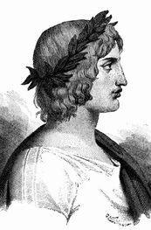
“Felix, qui potest rerum cognoscere causas”
“Fortunate, who is able to know the causes of things”
Also, being able to code your way towards
understanding cause and effect
leads to good jobs and bragging rights

Slide 5
Suggested project/markdown report guide
Introduce the problem. What is the question(s) you’re trying to answer?
Show what you’ve got. Load data and show a few descriptive stats – what are the variables we need to understand? Do you need to manipulate your variables in any way? What are the sources of the data? Visuals are better than large tables.
Model. Run a regression model or a few – what do you think should be in it and why?
What does it mean? Interpret your coefficients (significance, units etc.)
Highlight possible issues. Could we have a problem with endogeneity? If so, what exactly could be happening in our context – reverse causality? Omitted variable bias? Selection bias?
Fix it, if you can. If you can fix it, go ahead (you will learn more about how to do that in upcoming lectures), if not, showing that you understand the problem is good enough

Slide 6
Loading packages, data & poking around (learn to do this well!)
Just checking everyone ok with this…
Install and load packages you need (e.g. dplyr, tidyr, haven, reader, foreign…)
Loading data with different formats (Excel, CSV, DTA)
Loading data from different ‘places’ – dropbox/your directory
Dropbox links are best – do you know how to get one? (Remember to set dl=1 at the end of your link)
View the loaded dataset & investigate it (summary(), str(), nrow(), ncol(), names(), head(), view())
You can see a lot of things just by clicking but know the commands too

Slide 7
Deplyr vs base R
There are always multiple ways to do the same thing in R.
Why do we use the piping?
It makes code easier to read and it’s a more ‘modern’ way of coding but you don’t have to.
This
Is the same as this:
Is the same as this:

Slide 8
Manipulating variables
When we first load our variables, R might not know what type of variables we are dealing with – e.g. it might think your dates are words.
You need to google and play around but here’s some code to get you started:
Turn string variable into date:
ETS <- ETS_complete_stocks %>% mutate(Date = as.Date(Date,"%d.%m.%Y"))
Turn string into numeric:
ETS$Adj.Close <- as.numeric(as.character(ETS$Adj.Close))
Create a dummy variable:
HE <- as.integer(data$education=="some col" | data$education=="col+") mean(HE)

Slide 9
Descriptive stats
Often, you want to show frequencies or summary stats for a selection of variables or by a group of observations.
Summary stats for select variables:
auto_summary <- auto %>% select(mpg, weight) %>%
summarise_all( list(mmm=mean, p50=median, sd=sd ) )
Making things look decent is always a good idea:
auto_summary_reshape <- auto_summary %>% gather(stat, val) %>% separate(stat, into = c("var", "stat"), sep = "_") %>% spread(stat,val)
Summary stats by group:
usdaily=covid %>% group_by(date) %>% summarise(deaths=sum(deaths),cases=sum(cases))
Even better-looking tables in markdown:
knitr::kable(auto_summary_reshape)

Slide 10
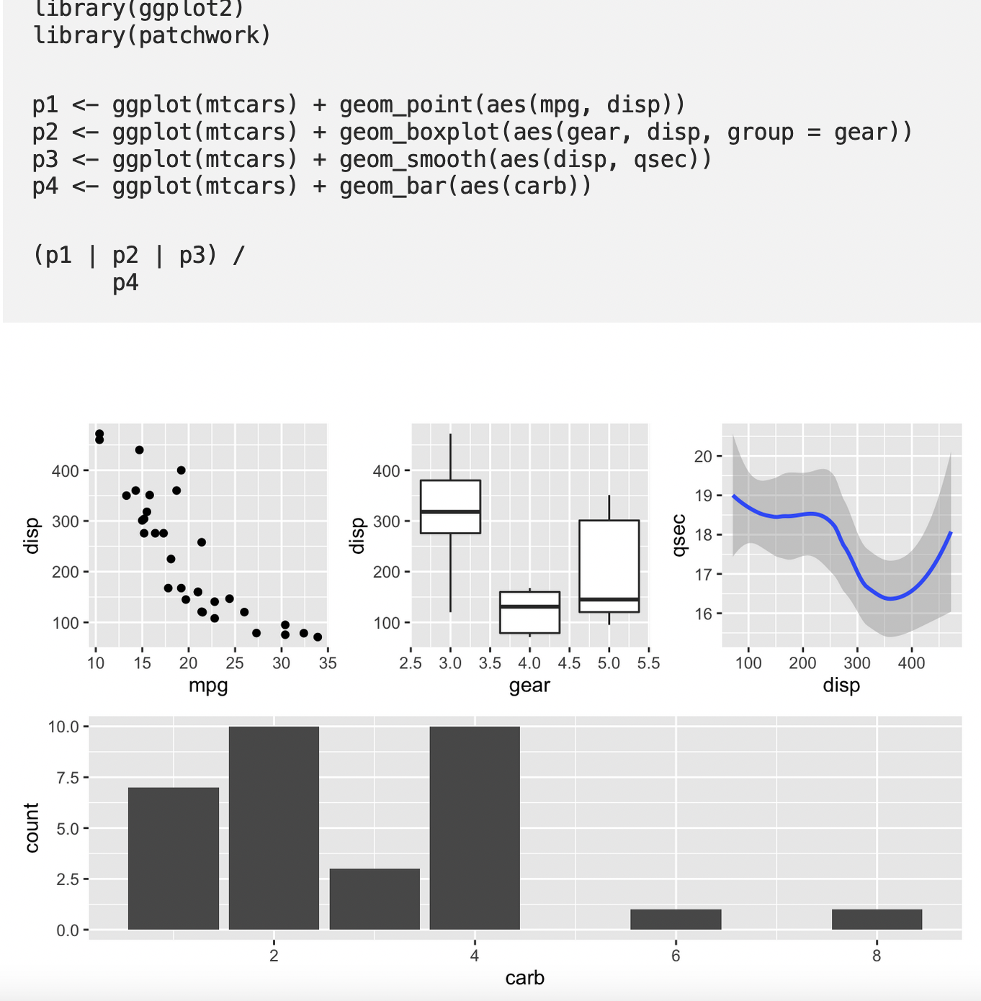
Visualise it
Lots of options but perhaps most common are:
Scatter plots to visualise a relationship between two vars (+fit a line)
Simple line charts to show trends over time
ggplot(covid_julyb, aes(x=density, y=casesOpop000 ))+ geom_point() + geom_smooth(method=lm)

Slide 11
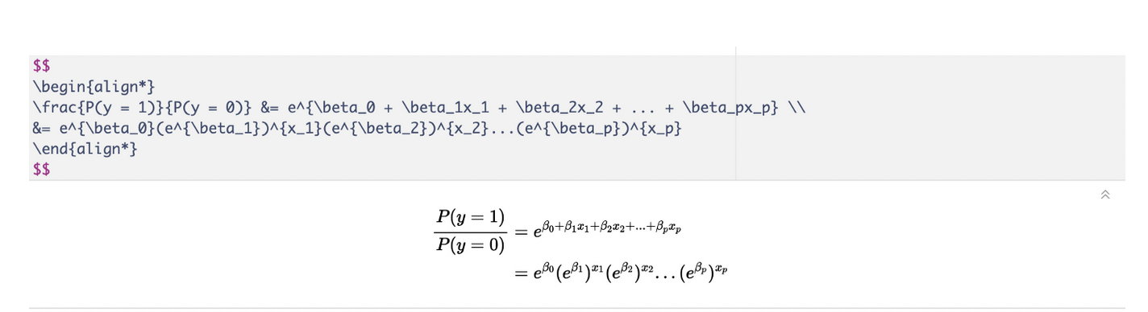
Equations
Include an equation that shows your model in your report. In R Markdown you can use LaTeX math notation.
You’ll need to install tinytex package. Then you can write equation inline by placing it between $ symbols. If you want the math in its own paragraph you can place it between $$ symbols. You do not need to know LaTeX – just google it. It’s much easier than it looks!

Slide 12
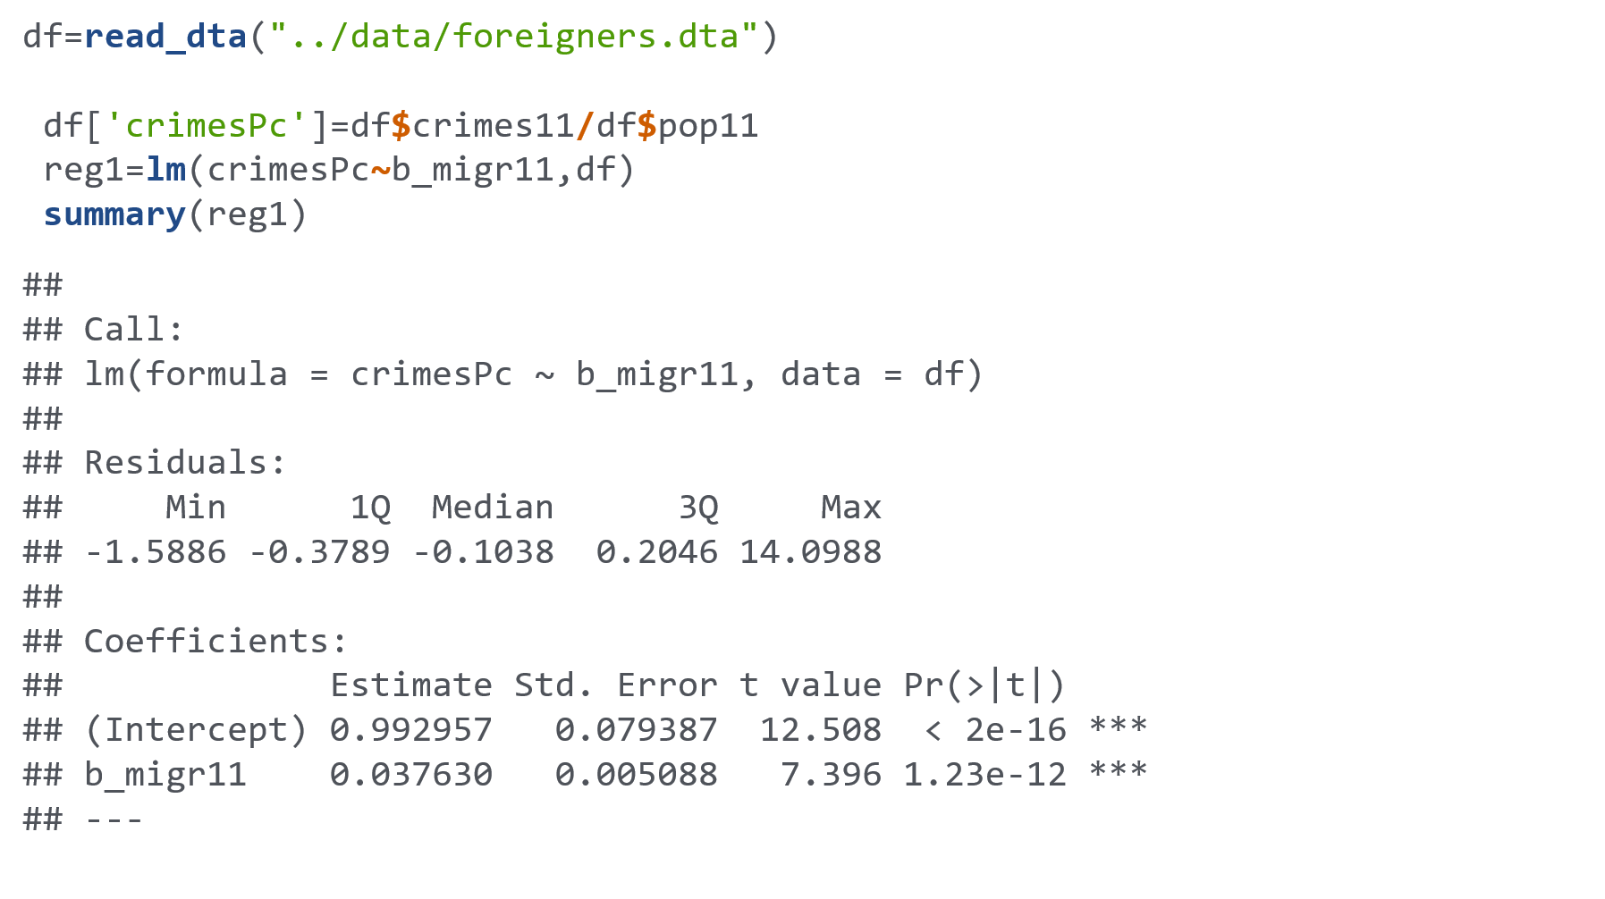
Regressions & understanding output (requested topic) OLS mod <- lm(call~black,data) Logit mod2 <- glm(call~black,data,family=binomial)
Notes:
Logistic regression can be interpreted as modelling log odds (i.e those who smoke >25 cigarettes a day are 6 times more likely to die before 65 years of age).

Slide 13
Hypothesis testing in R (requested topic)
library(foreign)
library(lmtest)
library(car)
linearHypothesis()
mod2 <- lm(wage~educ+educ*female,data)
summary(mod2)
Regression output tells us the individual significance of the coefficients. If they are not individually significant, they may still be jointly significant.
linearHypothesis(mod2,c("educ:female=0","female=0"))
=> a joint significance test reveals if the variables combined have explanatory power; i.e. the low significance in the regression may have been a consequence of co-linearity of the female and female*education variables.

Slide 14
Requested topics: what is Rnorm (and MC simulations more generally)
This is basically running a regression backwards. You make your data and then see if the coefficients turn out the way you expect them to. Here, we generate variables that follow our model Y=2+0.5X+ϵ
obs<-100
df=data.frame(eps=rnorm(obs))
df=df%>% mutate(X=runif(obs))
df=df%>% mutate(Y=2+0.5*X+eps)
hist(df$eps)
hist(df$X)
reg=lm(Y~X,df)
summary(reg)
beta <- double(1000)
for(i in 1:1000){
df=data.frame(eps=rnorm(obs))
df=df%>% mutate(X=runif(obs))
df=df%>% mutate(Y=2+0.5*X+eps)
beta[i]<-lm(Y~X,df)$coefficients[[2]] }
mean(beta)
results=data.frame(beta)
ggplot(results, aes(x=beta)) + geom_histogram(color="black",fill="white",bins=40) + theme_minimal()
hist(beta)

Slide 15
Quick competition – prize for the fastest! Send markdown file to petra.sarapatkova09@imperial.ac.uk
Load the auto dataset (link in exercise 4.3. on datastories)
Include a table showing average price for foreign and domestic cars.
Include another table, using the original data, filtering out only the models the price of which is lower than 5000.
Add a new variable that gives a ratio of price/headroom.
5. Draw a box plot showing the distribution of mpg for domestic and foreign cars? Which group has a better (lower) median mpg?
6. Draw a scatter plot of price vs mpg with an orange regression line and without the default 95% confidence interval band.
7. Regress price on gear ratio and interpret the coefficient.
8. Is the regression coefficient significant? If so, at what level?
9. What is the predicted price of a car with a gear ratio of 3?
10. What is the range of the gear ratio variable (min-max)?

Slide 16

Code doesn’t work? Trouble shooting tips
1. R will only do what you’re asking it to do,
not what you think you’re asking it to do.
2. If in markdown – are code chunks correctly demarcated? Are your packages installed and loaded?
3. Go though your code in detail – any brackets missing etc.?
4. R can be cryptic in the error messages. Google your error message to know more!
5. Google some more! Copy-paste shamelessly.
6. Ask your mates/your TA/your lecturer
7. Keep trying! You cannot ’break R’ by making mistakes

Slide 17
Quiz – solution code (full markdown also on datastories repository)
install.packages("haven”)
library(haven)
auto=read_dta("https://www.dropbox.com/sh/rqmo1hvij1veff0/AACNkMy47ilXAMh3nmiIs_Bqa/auto.dta?dl=1")
install.packages("dplyr”)
library(dplyr)
table1=auto %>% group_by(foreign) %>% summarise(mean_price=mean(price))
knitr::kable(table1)
table2=auto %>% filter(price<5000)
knitr::kable(table2)
auto=auto%>%mutate(price_headroom_ratio=price/headroom)
install.packages("ggplot2")
library(ggplot2)
ggplot(auto, aes(x=foreign, y=mpg, group=foreign)) + geom_boxplot()
ggplot(auto, aes(x=mpg, y=price)) + geom_point() + geom_smooth(method=lm, se=FALSE, color="orange")
mod1 <- lm(price~gear_ratio,auto)
summary(mod1)
mod1$coefficients[[1]]+mod1$coefficients[[2]]*3
summary(auto$gear_ratio)

Slide 18
Interpretation of coefficients
EXTRA
The 4 commandments
Check your variables (dummy, categorical, continuous….)
Check your logs! (log-log, level-log, log-level…)
Check your units (many frequently used variables e.g. wages are in 1000s)
Remember difference between percentage and percentage points

